Slide 1



UE23CS328C NLP Empowerment: Delving into Prompt Engineering and LLMs for enhanced capabilities
Day 3

Slide 2
Disclaimer The slides are prepared from various reliable sources from Internet and also include material from some content from various universities from abroad like Stanford, CMU etc.

Slide 3
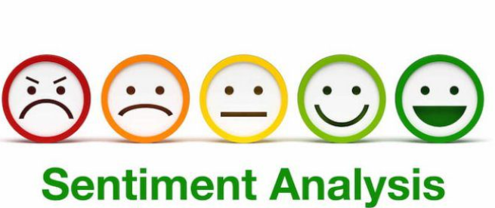
Today’s Agenda: 1. Sentiment Analysis 2. Text Summarization 3. Document Clustering 4. Topic Modeling
Presenter: Dr. arti arya

Slide 4
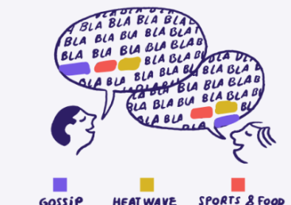
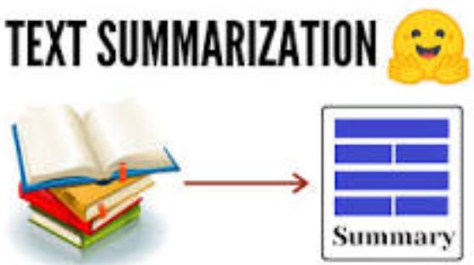
Elaborated Agenda
1. Sentiment Analysis
What is Sentiment Analysis?
Why Important to analyse sentiments?
Different Types of Sentiment Analysis.
Discussion of Hate Speech Paper
2. Text Summarization
Types of Text Summarization .
Application Areas
Algorithms
3. Document Clustering
Types of Text Summarization .
Application Areas
Algorithms
4. Topic Modeling
What is Topic Modeling?
What are different algos for Topic Modeling?
Details of LDA
Applications of Topic Modeling
4.

Slide 5
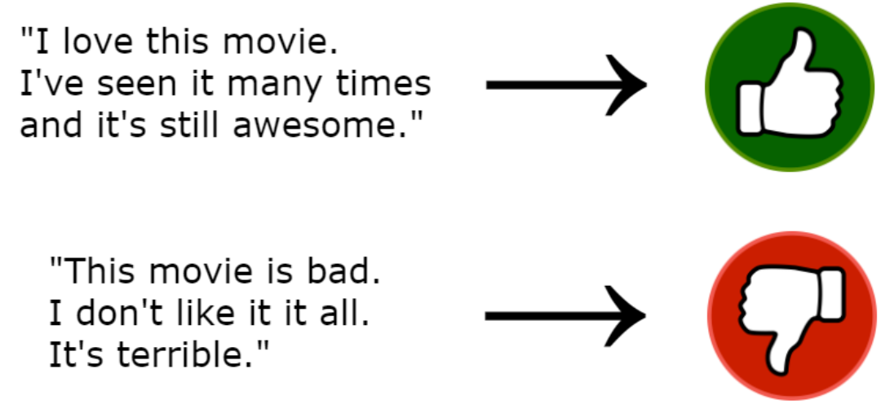
Sentiment Analysis
Positive or Negative Movie Reviews:
Source: https://web.stanford.edu/~jurafsky/slp3/slides/7_Sent.pdf

Slide 6
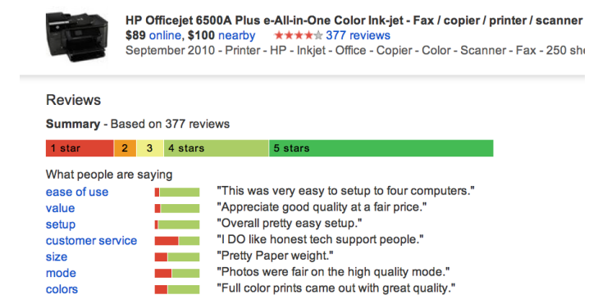
Sentiment Analysis
Amazon Reviews
Source: https://web.stanford.edu/~jurafsky/slp3/slides/7_Sent.pdf

Slide 7
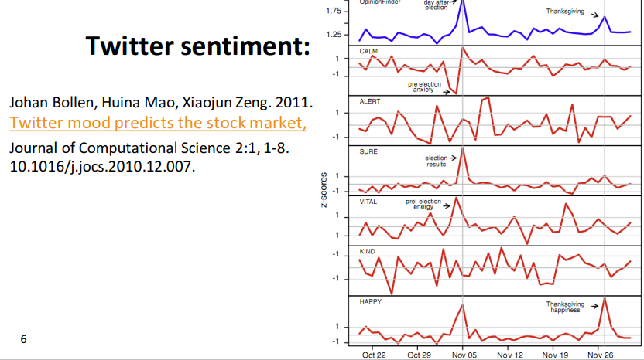
Sentiment Analysis
Twitter Sentiment for Stock Market Prediction
Source: https://web.stanford.edu/~jurafsky/slp3/slides/7_Sent.pdf

Slide 8

Other names
• Opinion extraction
• Opinion mining
• Sentiment mining
• Subjectivity analysis

Slide 9
What is it?
The extraction of sentiment, the positive or negative orientation that a writer expresses towards some object. ( By Jurafsky)
E.g.
A review of a movie, book, or product on the web expresses the author’s sentiment toward the product,
An editorial or political text expresses sentiment toward a candidate or political action.
Extracting consumer or public sentiment is thus relevant for fields from marketing to politics.
Source: https://web.stanford.edu/~jurafsky/slp3/4.pdf

Slide 10

What is it?
It is text categorization or a text classification task.
Supervised machine learning process.
.
Source: https://web.stanford.edu/~jurafsky/slp3/4.pdf

Slide 11
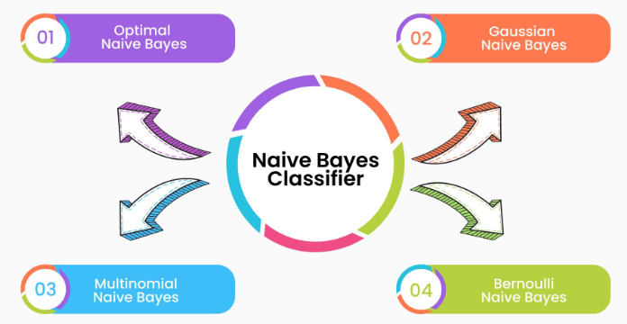
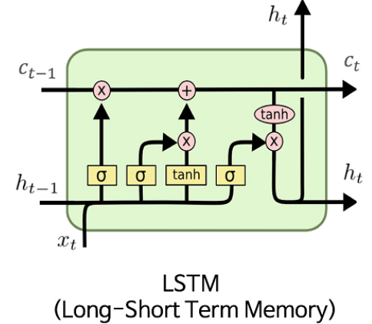
SA using different ML/DL Algos
1. Naïve Bayes Algorithm
2. LSTM

Slide 12
Baseline Algorithm
Tokenization
Feature Extraction
Classification using different classifiers
• Naïve Bayes
• MaxEnt
• SVM

Slide 13
Extracting Features for Sentiment Classification
• How to handle negation
• I didn’t like this movie
vs
• I really like this movie
• Which words to use?
• Only adjectives
• All words
• All words turns out to work better, at least on this data

Slide 14
Negation
Add NOT_ to every word between negation and following punctuation:
didn’t like this movie , but I
didn’t NOT_like NOT_this NOT_movie but I
Das, Sanjiv and Mike Chen. 2001. Yahoo! for Amazon: Extracting market sentiment from stock message boards. In Proceedings of the Asia Pacific Finance Association Annual Conference (APFA). Bo Pang, Lillian Lee, and Shivakumar Vaithyanathan. 2002. Thumbs up? Sentiment Classification using Machine Learning Techniques. EMNLP-2002, 79—86

Slide 15
Problems: What makes reviews hard to classify?
Subtlety:
Perfume review in Perfumes: the Guide:
• “If you are reading this because it is your darling fragrance,
please wear it at home exclusively, and tape the windows shut.”

Slide 16
Problems: What makes reviews hard to classify?
Thwarted Expectations and Ordering Effects:
“This film should be brilliant. It sounds like a great plot, the actors are first grade, and the supporting cast is good as well, and Stallone is attempting to deliver a good performance. However, it can’t hold up. ”
Well as usual Keanu Reeves is nothing special, but surprisingly, the very talented Laurence Fishbourne is not so good either, I was surprised.

Slide 17


Are these any longer problems??
With the advent of LLMs, the one of the most tedious areas ( or sub-branch) of AI has advanced by leaps and bound.
TRY OUT THE ABOVE SET OF SENTENCES WITH ChatGPT or even Google BARD and see what results do you get?

Slide 18
Types of Sentiment Analysis
Sen-tence Level
Doc-ument Level
Aspect Based
Entity Level
Emoti-on Based
Multi
lingual
Domain Specific

Slide 19
Types of Sentiment Analysis
Document-level Sentiment Analysis: This is the most basic form of sentiment analysis, where the sentiment of an entire document, such as a tweet, review, or article, is classified as positive, negative, neutral, or sometimes more fine-grained sentiment categories.
Sentence-level Sentiment Analysis: In this approach, the sentiment of individual sentences within a document is analyzed and classified independently. It can be useful for understanding how the sentiment varies within the text.
Aspect-based Sentiment Analysis: This type of sentiment analysis goes beyond document-level sentiment and aims to identify the sentiment associated with specific aspects or entities mentioned within the text. For example, in a product review, it may identify sentiments related to different product features.
Entity-level Sentiment Analysis: Similar to aspect-based analysis, entity-level sentiment analysis focuses on determining the sentiment towards specific entities or named entities (e.g., people, companies, products) mentioned in the text.
Multilingual Sentiment Analysis: This type of sentiment analysis involves analyzing sentiment in text written in different languages. It presents additional challenges due to language differences and varying cultural expressions of sentiment.
Emotion-based Sentiment Analysis: Rather than classifying sentiment as positive, negative, or neutral, emotion-based sentiment analysis aims to identify specific emotions expressed in the text, such as happiness, sadness, anger, fear, etc.
Domain-specific Sentiment Analysis: Sentiment analysis models can be trained specifically for certain domains like finance, healthcare, politics, or social media. This specialization helps achieve better accuracy for domain-specific contexts.

Slide 20
LSTM Model
LSTM is an extension/ improvement over RNNs( Recurrent Neural Networks).
RNNs can’t remember information (and long sentences) for a long time due to vanishing gradient problem.
To combat this situation, a variant of RNN was proposed: LSTM (takes care of vanishing gradient problem by using a special structure called Gate)

Slide 21
LSTM Model
What makes LSTM cells so special? How do LSTM cells achieve
long-term dependency?
How does it know what information to keep and what information
to discard from the memory?
This is all achieved by special structures called gates.
A typical LSTM cell consists of three special gates called
the input gate, output gate, and forget gate

Slide 22
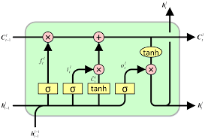

LSTM Model
The following the architecture of a LSTM cell
LSTM implements this concept of Selective Read, Selective Write and Selective Forget using gates and solves problem vanishing gradients.
However multiple gates lead to increase in number learnable parameters, and this is solved by one more modified architecture called GRU

Slide 23
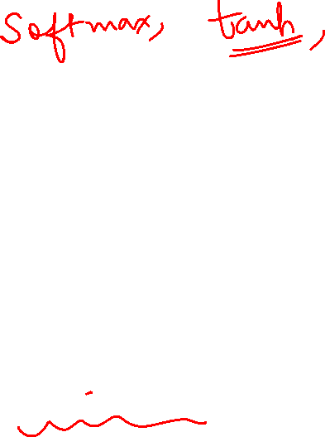
How is LSTM used for SA?
1. Load the dataset
2. Dataset Cleaning, encoding sentiment labels
3. Tokenization ( import Tokenizer)
4. Train LSTM Model using the training dataset(from tensorflow.keras import Sequential, LSTM, Dropout, Embedding)
( you will be using Sigmoid activation function and Adam optimizer and performance metric as Accuracy)
5. Then you will be plotting Loss ( you will get to know training and validation loss)
6. Model Testing

Slide 24
Hate Speech Paper

Slide 25
Text Summarization
Needs no introduction of the topic irrespective of whether you know NLP or not.
Automatically generating
a concise and coherent summary of a longer piece of text, such as an article, document, or webpage.
captures the most important and relevant information from the original text while retaining its key points.

Slide 26
Types of TS
TS
Extractive
Abstractive
Selecting and extracting the most important sentences or phrases directly from the original text
Generating new sentences that may not appear in the original text

Slide 27
Applications
News Aggregation
Document summarization
Social Media
Search engines
Conversational AI systems
Content curation platforms
Education
Market research platforms
Law firms
Automatic transcription
Medical and Healthcare

Slide 28
Approaches for TS
Use statistical techniques ( frequency analysis, sentence scoring etc)
RNNs, Transformer Based models like GPT-3 which captures complex patterns easily.
Focus on specific parts of the input text.
Supervised and unsupervised ML algos to recognize important sentences
Statistical Models
Machine Learning Models
Deep Learning Models
Attention Mechanism

Slide 29

Document Clustering
Groups similar documents together which can be used for a variety of tasks such as recommendations, similarity detection, creating dataset of a topic, generate new data following same pattern and so on
Source: https://iq.opengenus.org/document-clustering-nlp-kmeans/

Slide 30
Document Clustering
Today we’ll use TF-IDF and similarity metrics to use K-Means clustering algorithm to cluster documents.
Source: https://iq.opengenus.org/document-clustering-nlp-kmeans/

Slide 31
Applications of Document Clustering
In Info Retrieval, it ensures speed and efficiency.
It has important applications in Organization of Information or Data.
Used in Topic Extraction
Source: https://iq.opengenus.org/document-clustering-nlp-kmeans/

Slide 32
Document Clustering
Use TF-IDF for generating document vectors.
Compute similarity between document pair using the above TF-IDF data and a similarity metric.
Use a Clustering Algorithm (like K-Means) for grouping similar documents.
Source: https://iq.opengenus.org/document-clustering-nlp-kmeans/

Slide 33
Document Clustering
Consider the following corpus of documents
d1 - Jim Corbett National Park
d2 - Ghatprabha Bird Sanctuary
d3 - Bandipur National Park
d4 - Ranthambore Tiger Sanctuary
FYI: A corpus contains text and speech data that can be used to train AI and machine learning systems.
Source: https://iq.opengenus.org/document-clustering-nlp-kmeans/

Slide 34
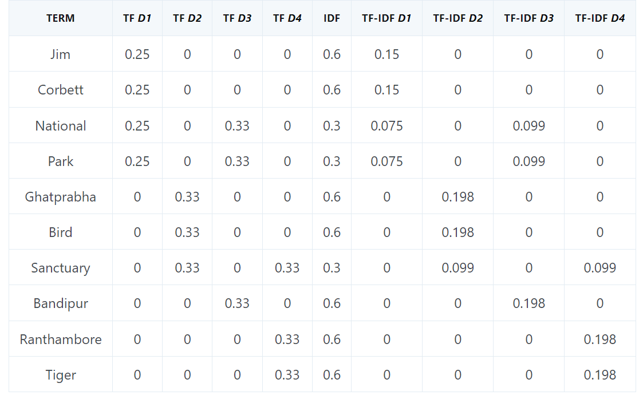
Document Clustering
Compute the tf-idf scores for the terms in each document
Source: https://iq.opengenus.org/document-clustering-nlp-kmeans/

Slide 35

TF-IDF
A statistical method in NLP and information retrieval.
It measures the importance of a term within a document relative to a collection of documents (i.e., relative to a corpus).
Words within a text document are transformed into importance numbers by a text vectorization process.
Source: https://www.learndatasci.com/glossary/tf-idf-term-frequency-inverse-document-frequency/

Slide 36
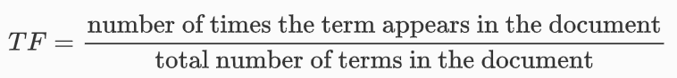
TF-IDF
Term Frequency: TF of a term or word is # of times the term appears in a document compared to the total number of words in the document.
Source: https://www.learndatasci.com/glossary/tf-idf-term-frequency-inverse-document-frequency/

Slide 37
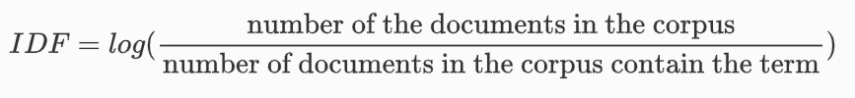
TF-IDF
IDF:
IDF of a term reflects the proportion of documents in the corpus that contain the term.
Words unique to a small percentage of documents (e.g., technical jargon terms) receive higher importance values than words common across all documents (e.g., a, the, and).
Source: https://www.learndatasci.com/glossary/tf-idf-term-frequency-inverse-document-frequency/

Slide 38
TF-IDF
The popular machine learning Python library Sklearn has TfidfVectorizer() function .
Source: https://www.learndatasci.com/glossary/tf-idf-term-frequency-inverse-document-frequency/

Slide 39
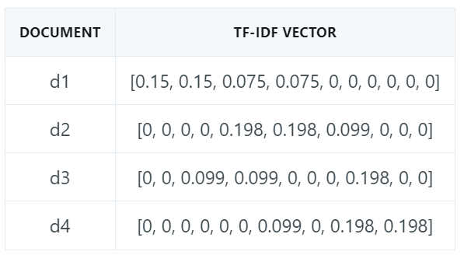

Document Clustering
Thus, the document vectors are as follows:
Source: https://iq.opengenus.org/document-clustering-nlp-kmeans/

Slide 40
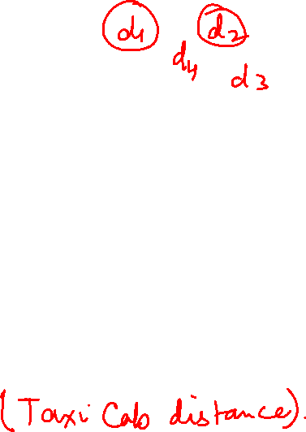
Step 2: K-means clustering algo
1. Let us initialize the first 2 points as the initial cluster centres. ( k=2)
C1 = [0.15, 0.15, 0.075, 0.075, 0, 0, 0, 0, 0, 0]
C2 = [0, 0, 0, 0, 0.198, 0.198, 0.099, 0, 0, 0]
2. Then, we find the distances of the other points w.r.t the cluster centres.
Let’s use Manhattan Distance.
Source: https://iq.opengenus.org/document-clustering-nlp-kmeans/

Slide 41
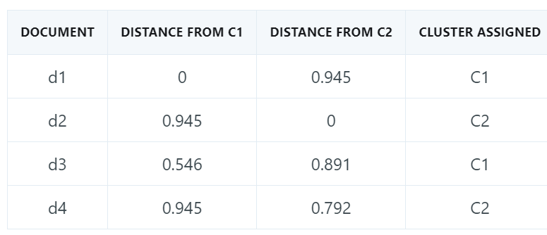
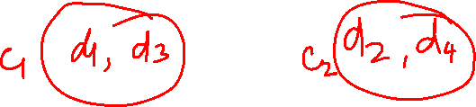
Step 2: K-means clustering algo
Assign clusters based on minimum distances.
Source: https://iq.opengenus.org/document-clustering-nlp-kmeans/

Slide 42
Step 2: K-means clustering algo
4. Cluster centres are updated.
These updated centres are obtained as follows:
D1: [0.15, 0.15, 0.075, 0.075, 0, 0, 0, 0, 0, 0]
D3: [0, 0, 0.099, 0.099, 0, 0, 0, 0.198, 0, 0]
New Updated centres: [(0.15+0)/2, (0.15+0)/2,(0.75+0.099)/2,…………]
C1 = [0.075, 0.075, 0.087, 0.087, 0, 0, 0, 0.099, 0, 0]
C2 = [0, 0, 0, 0, 0.099, 0.099, 0.099, 0, 0.099, 0.099]
Source: https://iq.opengenus.org/document-clustering-nlp-kmeans/

Slide 43
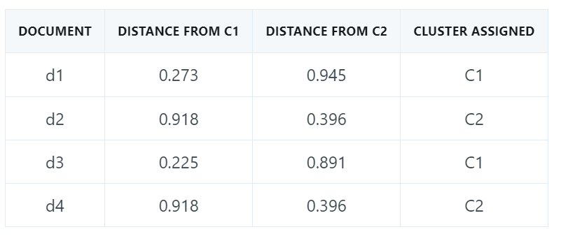
Step 2: K-means clustering algo
Repeat step 4.
So D1 and D3 are clustered together and D2 and D4 are grouped together.
There will be no more iterations since the clusters centres remain the same
Source: https://iq.opengenus.org/document-clustering-nlp-kmeans/

Slide 44

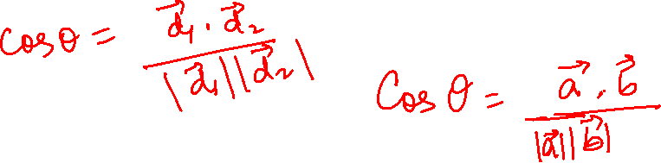
A Question?
Using Cosine Similiarity be a useful factor for Document Clustering?
Yes, Cosine Similarity can be converted to Cosine Distance, which, in turn, can be used as the distance measure to compute cluster centres in the K-Means Clustering Algorithm.
Source: https://iq.opengenus.org/document-clustering-nlp-kmeans/

Slide 45
Cosine Similarity: A quick Note
Cosine similarity is a metric used to measure how similar the documents are irrespective of their size.
Mathematically, it calculates the cosine of the angle between two vectors projected in a multi-dimensional space.
Source: https://iq.opengenus.org/document-clustering-nlp-kmeans/

Slide 46
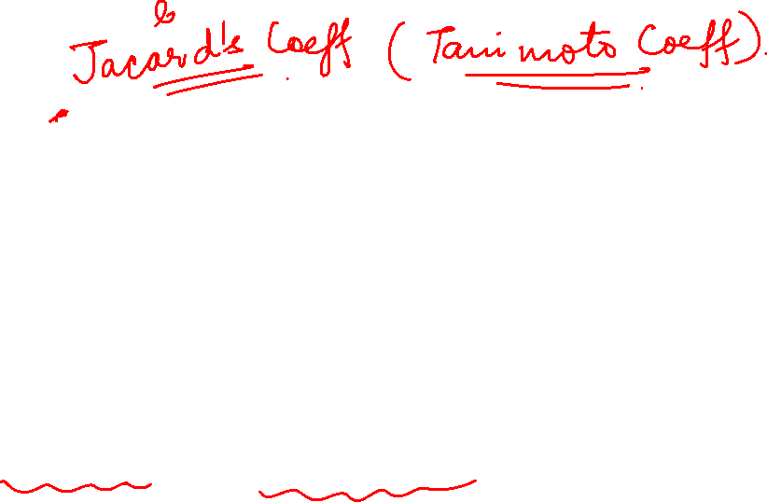
Cosine Similarity: A quick Note
Even if the two similar documents are far apart by the Euclidean distance because of the size (for example, the word “chatbot” could appear 50 times in one document and 10 times in another), they could still have a smaller angle between them.
Smaller the angle, the higher the similarity.
Source: https://iq.opengenus.org/document-clustering-nlp-kmeans/

Slide 47

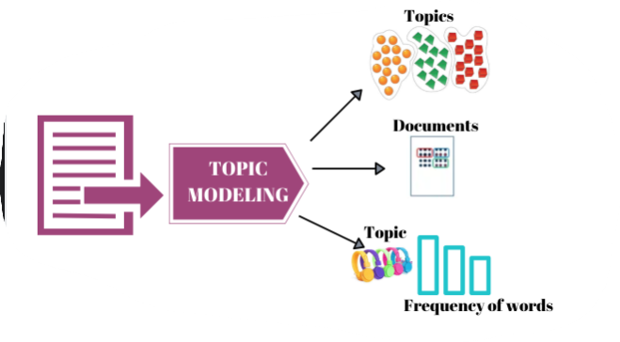

Topic Modeling
Topic modeling is an NLP technique used to identify and extract hidden themes or topics from a large corpus of text.

Slide 48
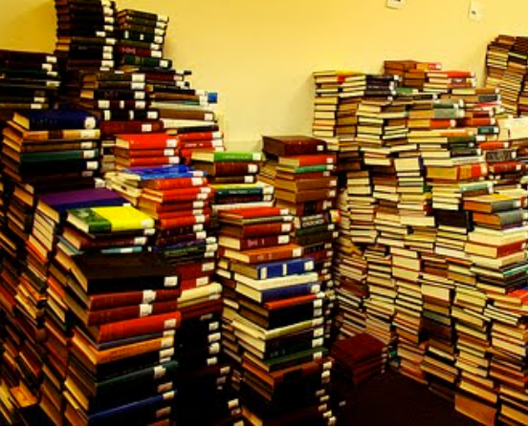
Topic Modelling: Motivation
Suppose you’re given a massive corpora and asked to carry out the following tasks
• Organize the documents into thematic categories
• Describe the evolution of those categories over time
• Enable a domain expert to analyze and understand the content
• Find relationships between the categories
• Understand how authorship influences the content

Slide 49

Topic Modelling
A method of (usually unsupervised) discovery of latent or hidden structure in a corpus
Applied primarily to text corpora, but techniques are more general.
Provides a modeling toolbox .
Has prompted the exploration of a variety of new inference methods to accommodate large-scale datasets

Slide 50

Topic Modelling
An unsupervised learning approach that identifies the underlying structure of the text data without any pre-defined categories or labels.
The most popular algorithm for topic modeling is Latent Dirichlet Allocation (LDA).

Slide 51

Goal of Topic Modelling
The goal is to assign probabilities to each word for different topics and probabilities to each document for different topic mixtures.
It assumes that each document contains a mixture of multiple topics, and each topic is represented by a distribution of words.

Slide 52

Topic Modelling
The output of topic modeling is a set of topics, each associated with a set of representative words, and a distribution of topics for each document.
It helps in understanding the main themes present in the document collection and can be used for tasks like document summarization, content recommendation, and information retrieval.

Slide 53
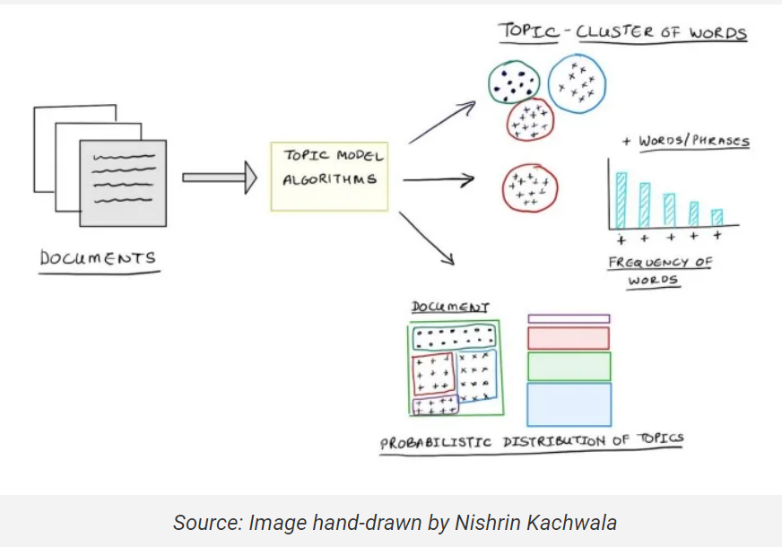

Slide 54
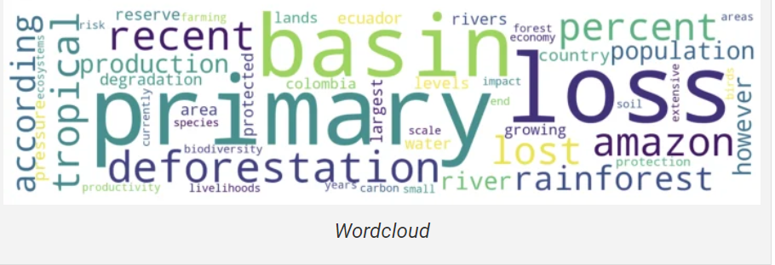
Topic Modelling
The topics present in the text are visualized using word clouds.
Here’s one such word cloud about deforestation, loss of green cover in certain habitats, and geographical regions.
The bigger and bolder the word appears, the more often it's mentioned within a given text and the more important it is.

Slide 55

Latent Dirichlet Allocation(LDA)
Popular topic modeling technique to extract topics from a given corpus.
The term latent conveys something that exists but is not yet developed.
Latent means “hidden or concealed”.
The topics that are to be extracted from the data are also “hidden topics”.

Slide 56
Latent Dirichlet Allocation(LDA)
The LDA makes two key assumptions:
Documents are a mixture of topics, and
Topics are a mixture of tokens (or words)

Slide 57
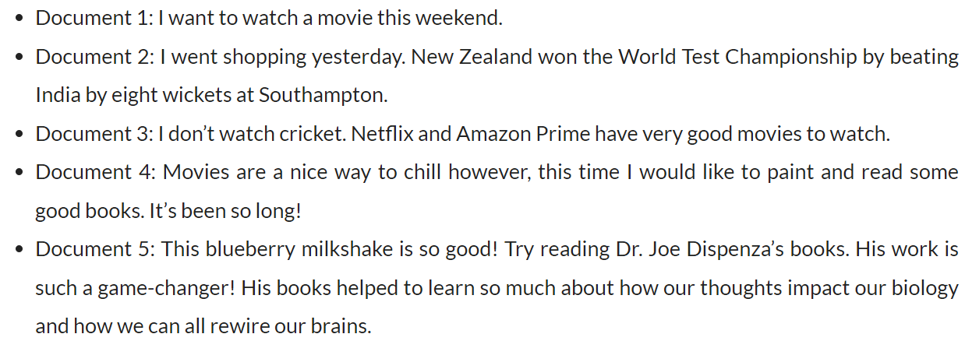
How does LDA work?
Consider the following Corpus:
Source: https://www.analyticsvidhya.com/blog/2021/06/part-2-topic-modeling-and-latent-dirichlet-allocation-lda-using-gensim-and-sklearn/#:~:text=Latent%20Dirichlet%20Allocation%20(LDA)%20is,are%20also%20%E2%80%9Chidden%20topics%E2%80%9D.

Slide 58
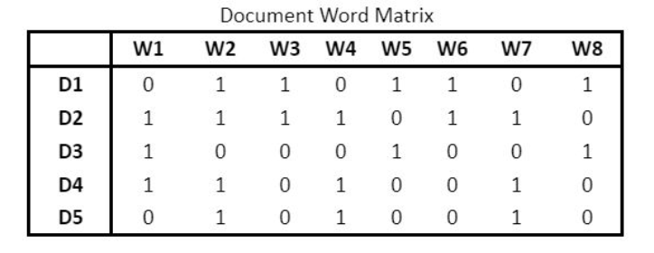
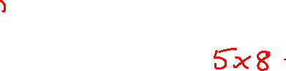

Representation as a DTM
The text data is cleaned, preprocessed and tokenized.
So, we get the following document term matrix(DTM) where:
D1, D2, D3, D4, and D5 are the five documents, and
The words are represented by the Ws, say there are 8 unique words from W1, to W8.
Hence, the shape of the matrix is 5 * 8

Slide 59
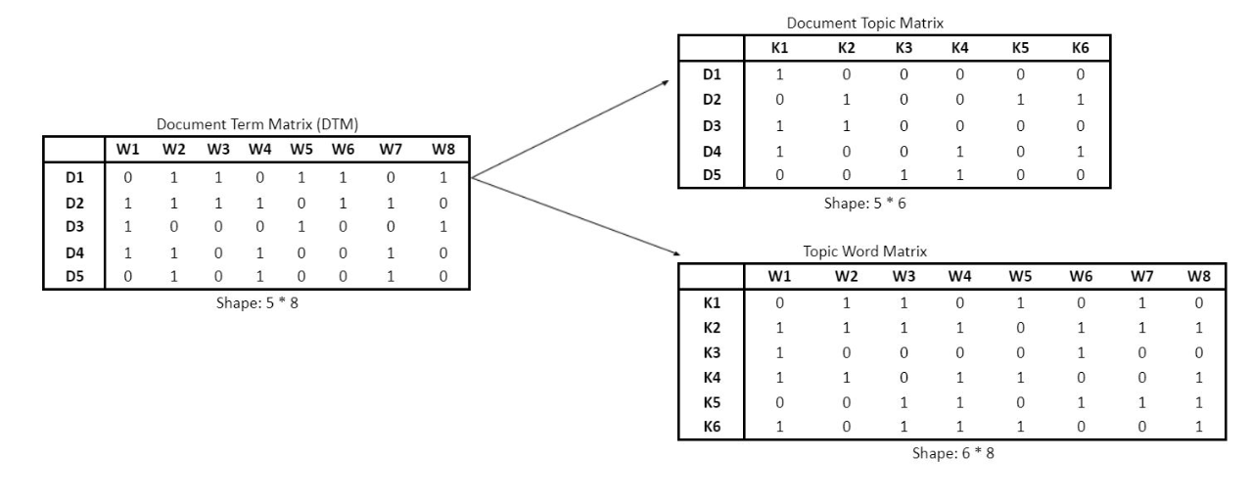
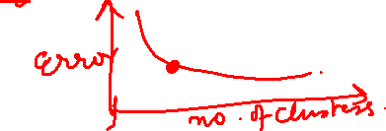
Representation as a DTM
Now the Corpus is converted to DTM.
LDA converts this document-word matrix into two other matrices:
Document Topic matrix and
Topic Word matrix
Source: https://www.analyticsvidhya.com/blog/2021/06/part-2-topic-modeling-and-latent-dirichlet-allocation-lda-using-gensim-and-sklearn/#:~:text=Latent%20Dirichlet%20Allocation%20(LDA)%20is,are%20also%20%E2%80%9Chidden%20topics%E2%80%9D.

Slide 60
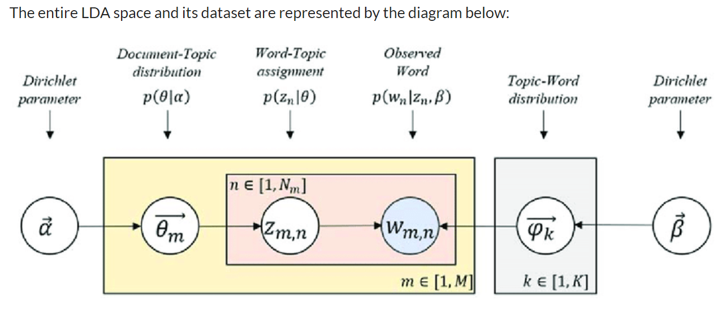

LDA Vector Space
According to LDA, every word is associated (or related) with a latent (or hidden) topic, which here is stated by Z.
Inside the peach box, there can be many words. One of those words is w, which is in the blue circle.
The yellow box refers to # the documents in the corpus (represented by M). M=5
Peach box is the # of words in a document, given by N

Slide 61
LDA Vector Space
The LDA model has two parameters that control the distributions:
Alpha (ɑ) controls per document topic distribution, and
Beta (ꞵ) controls per topic word distribution
Source: https://www.analyticsvidhya.com/blog/2021/06/part-2-topic-modeling-and-latent-dirichlet-allocation-lda-using-gensim-and-sklearn/#:~:text=Latent%20Dirichlet%20Allocation%20(LDA)%20is,are%20also%20%E2%80%9Chidden%20topics%E2%80%9D.

Slide 62
LDA Vector Space
So overall:
M: # documents in the corpus
N: # words in the document
w: Word in a document
z: latent topic assigned to a word
theta (𝛳): is the topic distribution
LDA models parameters: Alpha (ɑ) and Beta (ꞵ)
Source: https://www.analyticsvidhya.com/blog/2021/06/part-2-topic-modeling-and-latent-dirichlet-allocation-lda-using-gensim-and-sklearn/#:~:text=Latent%20Dirichlet%20Allocation%20(LDA)%20is,are%20also%20%E2%80%9Chidden%20topics%E2%80%9D.

Slide 63
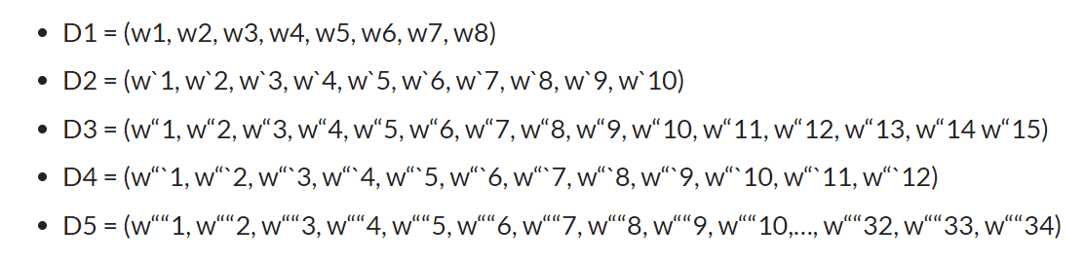
How will LDA optimize the distributions?
Now, our corpus that had 5 documents (D1 to D5) and with their respective number of words:
Source: https://www.analyticsvidhya.com/blog/2021/06/part-2-topic-modeling-and-latent-dirichlet-allocation-lda-using-gensim-and-sklearn/#:~:text=Latent%20Dirichlet%20Allocation%20(LDA)%20is,are%20also%20%E2%80%9Chidden%20topics%E2%80%9D.

Slide 64
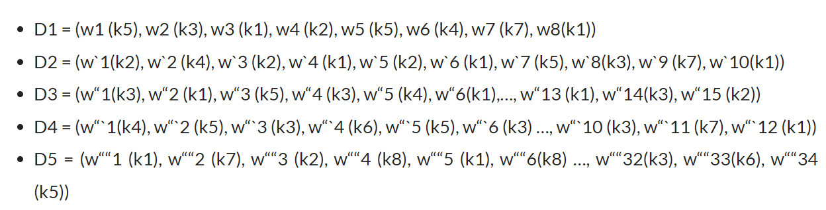
LDA is an iterative process
1st iteration, randomly assigns the topics to each word in the document.
The topics are represented by the letter k.
So, the words in the documents will be associated with some random topics like below:
Source: https://www.analyticsvidhya.com/blog/2021/06/part-2-topic-modeling-and-latent-dirichlet-allocation-lda-using-gensim-and-sklearn/#:~:text=Latent%20Dirichlet%20Allocation%20(LDA)%20is,are%20also%20%E2%80%9Chidden%20topics%E2%80%9D.

Slide 65
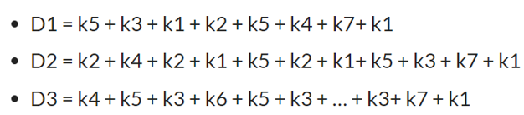
LDA is an iterative process
The documents are the mixture of the topics ((Assumption 1):
Similarly for other docs also.
Source: https://www.analyticsvidhya.com/blog/2021/06/part-2-topic-modeling-and-latent-dirichlet-allocation-lda-using-gensim-and-sklearn/#:~:text=Latent%20Dirichlet%20Allocation%20(LDA)%20is,are%20also%20%E2%80%9Chidden%20topics%E2%80%9D.

Slide 66
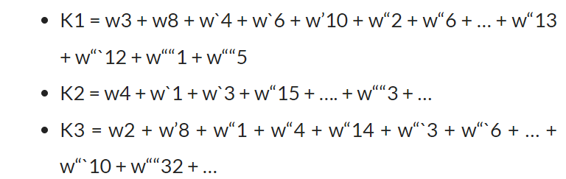
LDA is an iterative process
The topics are the mixture of the words ( Assumption 2):
Similarly, LDA will give the word combinations for other topics.
Source: https://www.analyticsvidhya.com/blog/2021/06/part-2-topic-modeling-and-latent-dirichlet-allocation-lda-using-gensim-and-sklearn/#:~:text=Latent%20Dirichlet%20Allocation%20(LDA)%20is,are%20also%20%E2%80%9Chidden%20topics%E2%80%9D.

Slide 67
After 1st iteration of LDA
LDA provides the initial document- topic and topic-word matrices.
The task at hand is to optimize these obtained results and LDA does by iterating over all the documents and all the words.
Source: https://www.analyticsvidhya.com/blog/2021/06/part-2-topic-modeling-and-latent-dirichlet-allocation-lda-using-gensim-and-sklearn/#:~:text=Latent%20Dirichlet%20Allocation%20(LDA)%20is,are%20also%20%E2%80%9Chidden%20topics%E2%80%9D.

Slide 68
Another interesting assumption by LDA
LDA makes another assumption that all the topics that have been assigned are correct except the current word.
LDA will iterate over:
each document ‘D’ and each word ‘w’
How would it do that?
It does so by computing two probabilities: p1 and p2 for every topic (k)

Slide 69
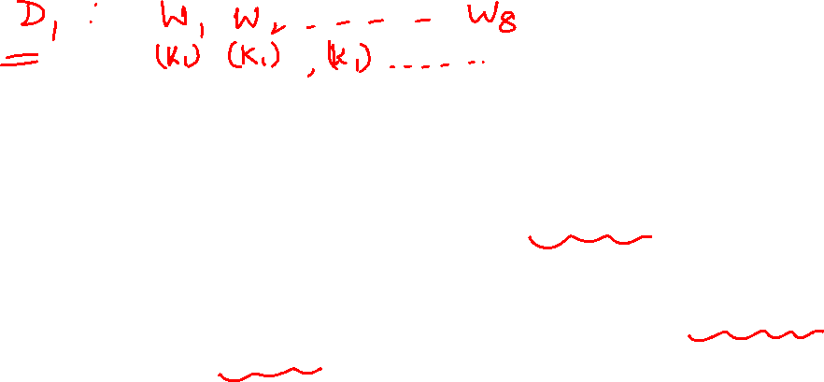
Another interesting assumption by LDA
P1:
proportion of words in the document (D) that are currently assigned to the topic (k)
P2:
is the proportion of assignments to the topic(k) over all documents that come from this word w. (In other words, p2 is the proportion of those documents in which the word (w) is also assigned to the topic (k))
The formula for P1 and P2 is:
P1 = proportion (topic k / document D) ,and
P2 = proportion(word w / topic k)

Slide 70
LDA
Now, using these probabilities P1 and P2, LDA estimates a new probability, which is the product of (P1*P2), and through this product probability, LDA identifies the new topic.
Source: https://www.analyticsvidhya.com/blog/2021/06/part-2-topic-modeling-and-latent-dirichlet-allocation-lda-using-gensim-and-sklearn/#:~:text=Latent%20Dirichlet%20Allocation%20(LDA)%20is,are%20also%20%E2%80%9Chidden%20topics%E2%80%9D.

Slide 71

Some other advanced TM algos/models
Top2Vec
Sentence BERT (S-BERT)
Non-negative Matrix Factorization (NMF)
GuidedLDA
Correlation Explanation (CorEx)
Source: https://www.analyticsvidhya.com/blog/2021/06/part-2-topic-modeling-and-latent-dirichlet-allocation-lda-using-gensim-and-sklearn/#:~:text=Latent%20Dirichlet%20Allocation%20(LDA)%20is,are%20also%20%E2%80%9Chidden%20topics%E2%80%9D.

Slide 72
DC for TM
Source: https://iq.opengenus.org/document-clustering-nlp-kmeans/

Slide 73
Few more relevant terminologies
One hot encoding
Dropout
Senticnet
SentiWordnet
Embeddings

Slide 74
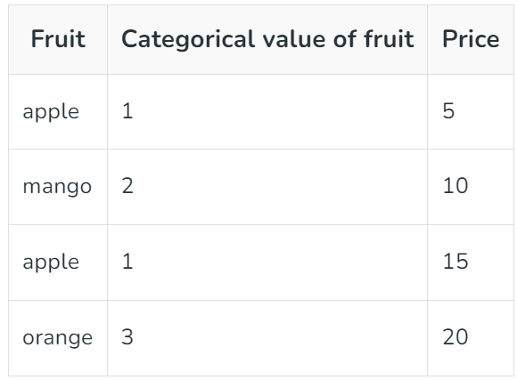
Few more relevant terminologies
One hot encoding
A technique that is used to represent categorical variables as numerical values in a machine learning model.

Slide 75
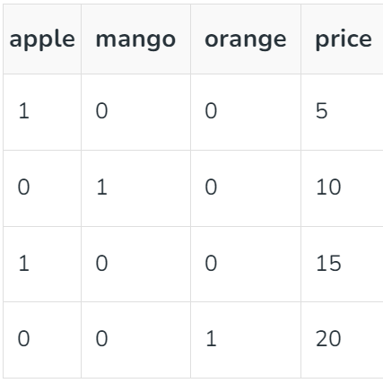
Few more relevant terminologies
The output after applying one-hot encoding on the data is given as follows,

Slide 76
Few more relevant terminologies
Word Embeddings
Defined as a numeric vector input that allows words with similar meanings to have the same representation.
Can approximate meaning and represent a word in a lower dimensional space.
These can be trained much faster than the hand-built models that use graph embeddings like WordNet.

Slide 77


